Slide 1

EcoChain: Decentralized Waste Management System
Revolutionizing Waste Management with Blockchain, IoT, and AI
SIH Problem ID: 1592
Team Name: Spark Squad

Slide 2
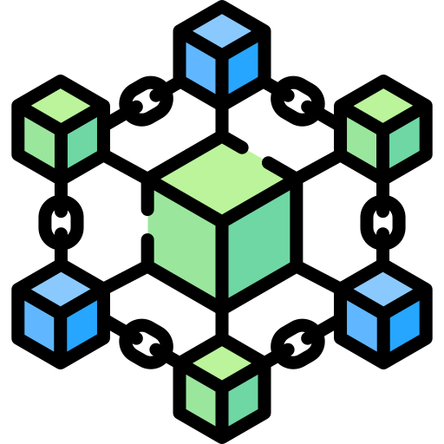

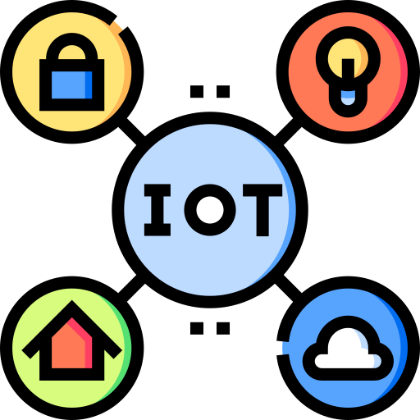


EcoChain is an innovative waste management solution leveraging Blockchain, IoT, and AI technologies.
Objective: Provide transparency, incentivize proper waste practices, and ensure community engagement.
Key Features:
Blockchain: Immutable records and transparency.
IoT: Real-time data collection from sensors.
AI: Predictive analytics and waste collection optimization.
Incentives: Token-based reward system.

Slide 3


Problem: Waste management is inefficient due to urbanization and industrialization. Traditional systems lack transparency and community engagement.
EcoChain’s Solution: A decentralized, tech-driven approach to waste management that uses Blockchain, IoT, and AI for a scalable, efficient system.

Slide 4
Technical Architecture
Blockchain Platform: Custom-made blockchain in Go.
Smart Contracts: Automated agreements for transparency and compliance.
IoT Integration: Smart bins with sensors and LPWAN technology (e.g., LoRaWAN) for data transmission.
AI Tools: TensorFlow/PyTorch for predictive analytics; CNNs for waste classification.
Backend: Node.js/Express or Python/Django.
Databases: MongoDB for unstructured data; PostgreSQL for structured data.
Security: AES-256 encryption, TLS for data in transit, OAuth 2.0 for authentication.
DevOps Tools: Docker/Kubernetes for containerization, Jenkins/GitLab CI for automated deployment.
Visual: Architecture diagram showing interaction between Blockchain, IoT sensors, AI, databases, and front-end systems.

Slide 5
Waste Segregation & Disposal
Waste Segregation: Smart bins equipped with sensors automatically classify waste (e.g., organic, recyclable, non-recyclable).
AI Route Optimization: Predicts and optimizes waste collection schedules to reduce fuel consumption and labor costs.
Recyclers' Marketplace: Blockchain-based bidding system for recyclers ensures competitive pricing for waste materials.

Slide 6
Community Engagement & Incentives
Workshops and Campaigns: Educating the public on waste segregation and proper disposal practices.
Incentive System: Community members earn tokens for proper waste disposal. Tokens can be redeemed for goods or services.
Community Competitions: Neighborhoods compete to see who can perform better in waste management, earning rewards.

Slide 7
Implementation Plan
Phase 1:
Initial Setup:
Deploy Blockchain and IoT infrastructure in pilot areas.
Set up smart bins and initiate token systems.
Phase 2:
Community Involvement:
Launch educational workshops and public awareness campaigns.
Begin the incentive program with token rewards.
Phase 3:
Full-Scale Deployment:
Expand system to new areas based on feedback and data analysis.
Continuous improvement via data-driven adjustments.
Timeline:
Phase 1: 3-6 months
Phase 2: 6-12 months
Phase 3: 1-2 years for full-scale deployment.

Slide 8
Conclusion
Summary: EcoChain offers a decentralized, transparent, and incentivized waste management solution using cutting-edge technologies (Blockchain, IoT, AI).
Benefits:
Increased transparency.
Improved efficiency in waste collection.
Higher community involvement.
Reduced environmental impact.
Call to Action: Explore partnership opportunities, initiate pilot programs, or further research.

